Slide 1
Logistic Regression VB Tool Quickstart
Ian Housman
January, 2013

Slide 2
Overview
Necessary data
Using the tool
Prepare predictors
Running the model

Slide 3
Necessary Data
Must have-
DEM
Preferably a 10m DEM, but will work with any projected elevation raster
Assumes pixel resolution is in meters, but will work if not (units will simply be in the incorrect format)
Recommended-
Binary training point shapefile with a predictor field with 1 = valley bottom and 0 = not valley bottom
The model can be run with default coefficients, but may not properly model the study area

Slide 4
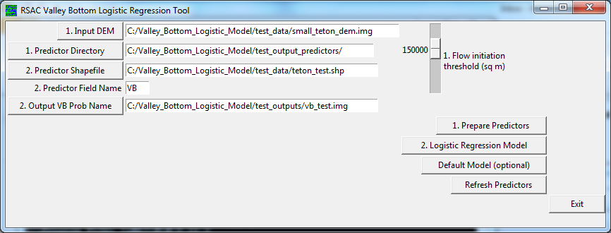
Using the tool
Ensure that the install script properly ran
Can run the RSAC_valley_bottom_logistic_model.py by editing the individual parameters at the bottom of the script or can use the GUI
Will only cover how to use the GUI
Double click the RSAC_valley_bottom_logistic_model_gui.py
GUI should pop up
If GUI does not pop up,
check the installation

Slide 5
Using the tool- prepare predictors
General layout
Numbers correspond to steps
E.g. prior to running prepare predictors, all inputs (left) with a 1. before it must be selected
Select an input DEM
Should have any unwanted areas set to NoData (0 values will be included)
Select a Predictor Directory
This is where all intermediate products and terrain predictors will be stored
Will automatically create any directory that is typed in the Predictor Directory entry area
Click the “Prepare Predictors” buttton
This will prepare common terrain indices

Slide 6
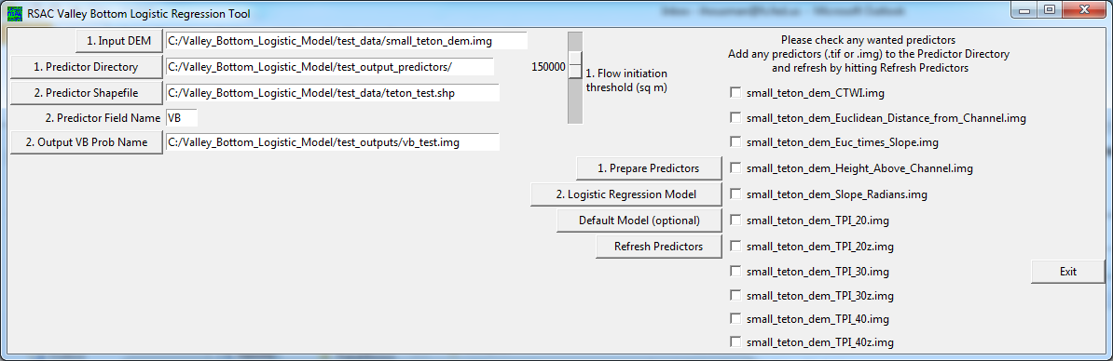
Using the tool- running the model
Once the tool has finished preparing the predictors, all .tifs and .imgs found in the Predictor Directory will be listed in the tool
If you are starting with an already prepared predictor directory, or would like to add more of your own predictors, add any .tif or .img to the predictor directory and press the “Refresh Predictors” button.
A default model can be run using the Default Model button
Coefficients for this model were derived from a study area in the Tetons, and therefore may or may not properly model the valley bottom probability within your study area

Slide 7
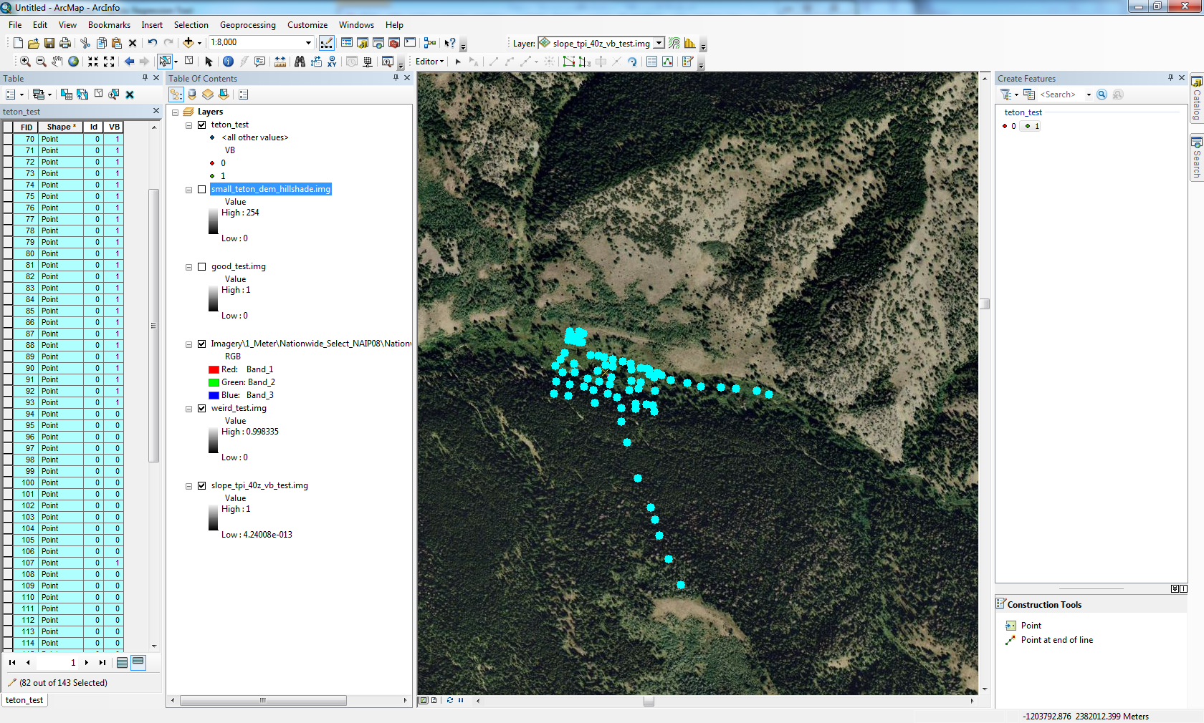
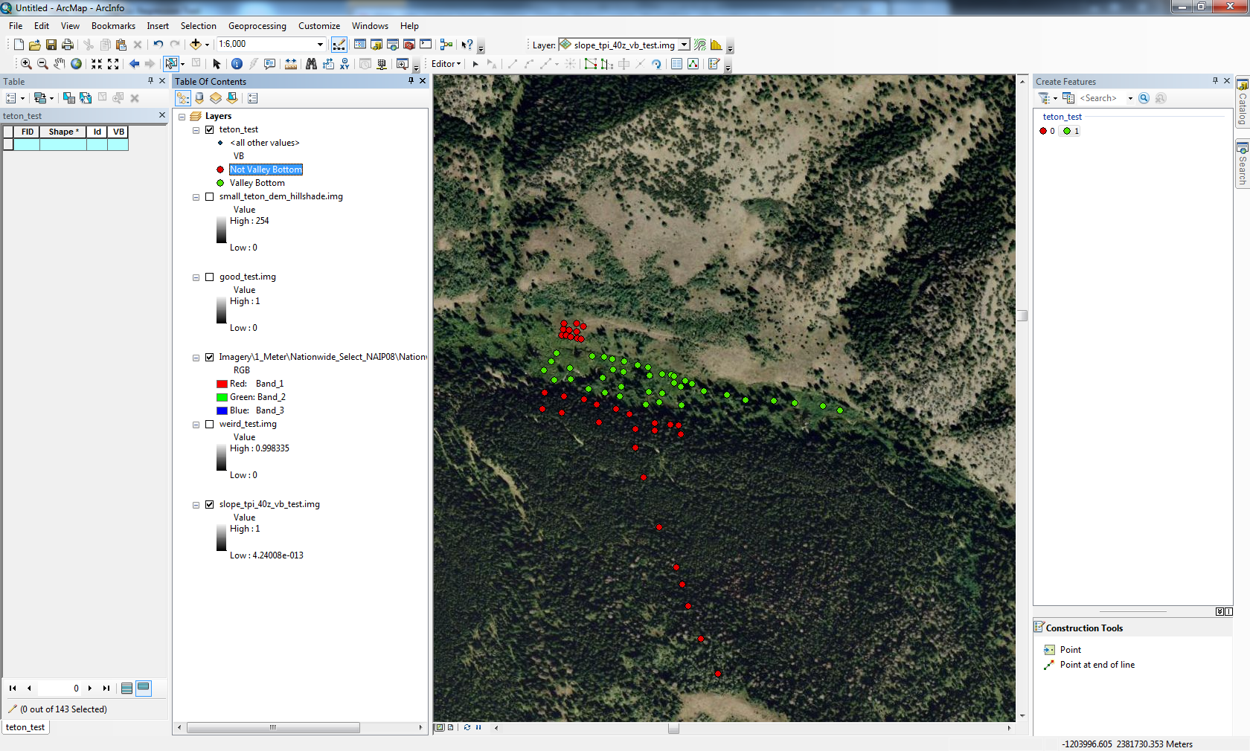
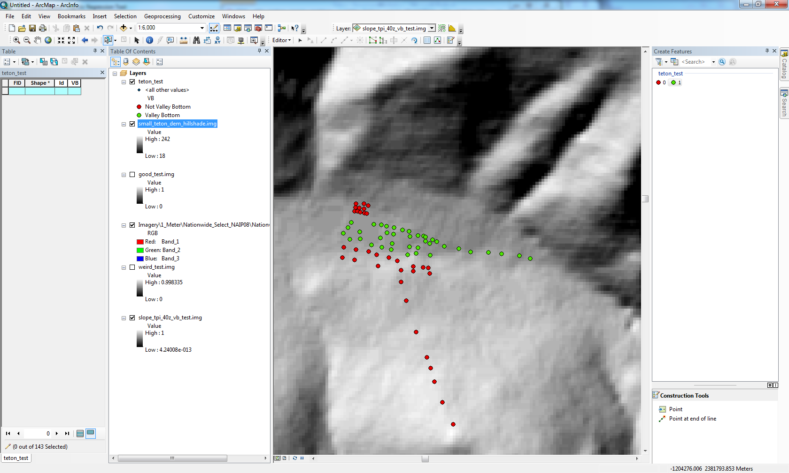
Using the tool- running the model cont’d
In order to run the model, a predictor shapefile must be provided
It must be a point shapefile with points within the study area
The shapefile must have a field with only 0 and 1 values corresponding to whether the point location is within a valley bottom or not (left)
The general idea is to find areas that properly contrast valley bottoms from upland areas (center)
Points can be placed in transect and/or contour patterns (below)
Attribution is done through a combination of image and terrain interpretation generally using NAIP and a hillshade
The tool allows for quick experimentation, so the points do not have to be perfect the first time
NAIP
Hillshade

Slide 8
Using the tool- running the model cont’d
Once a training dataset is created it must be selected as the “Predictor Shapefile.”
Next, ensure the predictor field name lines up with the chosen predictor field name
Then select an output VB prob name. It can simply be typed into the entry box or selected using the button
If the directory does not exist, it will be created automatically
It is recommended that the folder the output is placed in is different from the predictor folder
If it is not, when the predictors are refreshed, any outputs will be included in the check list inside the tool

Slide 9
Evaluating outputs and re-running the tool
Run tool
Evaluate output
Qualitatively identify any areas that are modeled incorrectly
Decide whether different predictors should be used to improve the model or more training data are needed
Select different predictors and/or place more training data
The general iterative process of running the model, evaluating the output, and editing the training data and/or selecting different predictors is outlined to the right
This process is generally carried out several times to arrive at a satisfactory output
Final valley bottom extents can be derived by thresholding the valley bottom probability

Slide 10
Tips
It is important to consider the spatial scale of the data
Do not place training data on features that are a finer scale than the DEM being used
When creating training data, ensure that they consistently depict what a valley bottom is
Try not to have too many points in areas that YOU find confusing to classify (most likely the model will find this confusing as well)
Some additional terrain predictors that are not included that have been documented to be useful in low-relief areas are:
Height above hydric soils
Inverse Strahler stream order-weighted height above channel

Slide 11
Contact:
Ian Housman
ihousman@fs.fed.us

